Slide 1
Linalool
By: Jason & Raquel

Slide 2
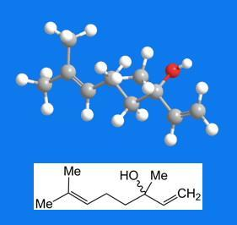
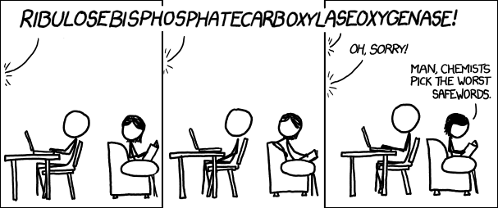
What’s truly important… plus a picture of the molecule

Slide 3
Linalool
Chemical Formula: C₁₀ H₁₇ OH
Molar Mass: 154.25 g/mol
Density: 858 kg/m³
Melting Point: <20°C
Boiling Point: 198-199°C
Water Solubility: 854 mg/l (23.5 °C) – 1589 mg/l (25 °C)

Slide 4
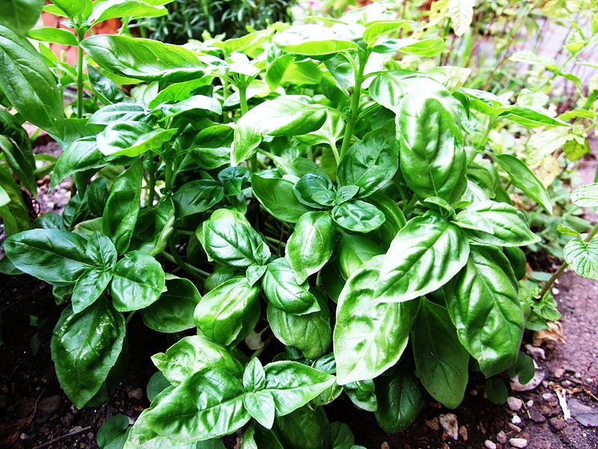
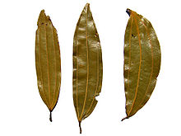
Linalool
First synthesized by F. Tiemann in 1898.
Naturally occurring Terpene Alcohol chemical found in many flowers and spice plants.
Linalool is used as a scent in 60–80% of perfumed hygiene products and cleaning agents.
Linalool when oxidized can cause allergic reactions such as eczema.

Slide 5

Linalool
Linalool is also a source of Vitamin E and can be used for killing insects such as fleas and cockroaches.
Akio Nakamura along with other scientists at the University of Tokyo claimed that Linalool can reduce stress in lab rats.
This shows potential of producing fragrances that can soothe stress.
Inhaling Linalool can also return genes that go into overdrive during stress such as neutrophils and lymphocytes back to normal.

Slide 6
Work Cited
http://portal.acs.org/portal/acs/corg/content?_nfpb=true&_pageLabel=PP_ARTICLEMAIN&node_id=841&content_id=CNBP_029800&use_sec=true&sec_url_var=region1&__uuid=98323f33-fa1e-46fb-9733-656608809989
http://www.inchem.org/documents/sids/sids/78706.pdf
http://xkcd.com/1039/

